Slide 1
NRECA’s National Discounts Program (NDP)
An overview for Prospective Suppliers

Slide 2

About the National Discounts Program
The Vision of NRECA’s National Discounts Program (NDP) is to become that trusted and reliable procurement resource for NRECA Co-op Members and employees as it relates to obtaining strategic value from sourcing and contracting activities and promoting the interests of NRECA’s members.
The Mission of NDP is simple - provide to NRECA Co-op Members and employees the greatest value from the negotiated goods and services purchased from Industry Leading Suppliers that can be obtained.
The Value that guides NDP is the belief in not interfering and or make individual sourcing decisions or purchases for Co-op Members. Rather, NDP strives to empower Co-op Members by using their aggregated purchasing power to aggressively negotiate discounts on products and/or services at a better value than member cooperatives might otherwise be able to obtain individually.

Slide 3
NDP Fundamentals
What is the NDP?
Negotiated discount program that leverages the collective buying power of Member Co-ops.
Wide variety of nationally recognized companies that offer savings!
How does NDP Work?
Who can use NDP?
Discount program is mainly for business needs (some personal programs)
All Member Co-op Employees including Board Members
Access the NDP page via Cooperative.com
Product and service discounts from nearly 100 participating businesses

Slide 4
What is the Goal of NDP?
Save Co-ops Money Offers deeper discounts, cost savings and value added services on cooperative’s procurement transactions
Provide Procurement Focus Pools the collective buying power of cooperative members for their Indirect procurements needs
Target Audience Available to all member cooperatives mainly for business use, but some programs can be used for personal use

Slide 5

NDP 2017 Co-op Member Highlights
NDP has provided $10.7 million in savings to Co-op Members
On Cooperative.com NDP’s page was visited 41.5K by Co-op Members
NDP Supplier
NDP Program Admin
Co-op Member Success!

Slide 6
NDP Co-op Member Foot Print
NRECA Co-op Members represent 47* of the 50 States and 1 US Territory
833 Distribution Co-ops
19.5K end-user electrical consumers
62 Generation and Transmission Co-ops
80K end-user electrical consumers
40 Statewide Co-ops
* (excludes CT, MA & RI)

Slide 7

Prospective NDP Supplier Selection Criteria
The Supplier(s) program can be broadly available for use by the majority of the cooperatives who are members of NRECA.
The Supplier(s) program must offer goods and services that are of interest to and/or of use to the cooperative members of NRECA.
The Supplier(s) program must offer a discount or other valuable considerations (i.e. training, maintenance, etc.) to NRECA cooperative members.

Slide 8

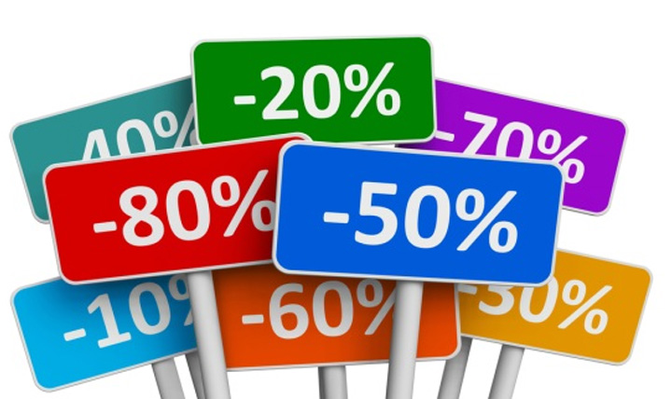
How Do I Become a Part of NDP?
If you would like to receive more information or join NRECA’s National Discounts Program, contact us via email at ndp@nreca.org or leave your discount suggestion on our For NRECA Suppliers page on Cooperative.com
We want to hear from you with your discount suggestions and how your prospective program will benefit our members!

