Slide 1
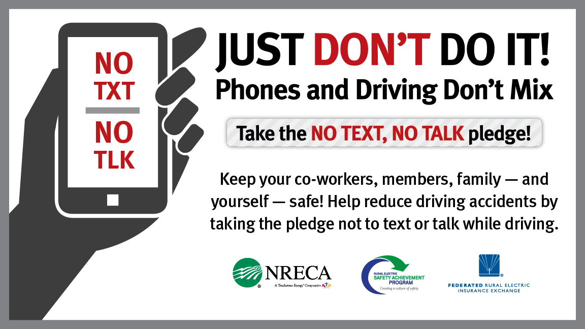
Notes:
Distracted driving due to phone use is a serious public health hazard
In fact, U.S. Dept. of Transportation calls it an epidemic
We have all seen distracted drivers, and most likely, everyone in this room has used their phone while driving or you have been in a car where the driver was using his/her phone
Resource: Dept. of Transportation Distracted Driving campaign: http://www.distraction.gov/

Slide 2
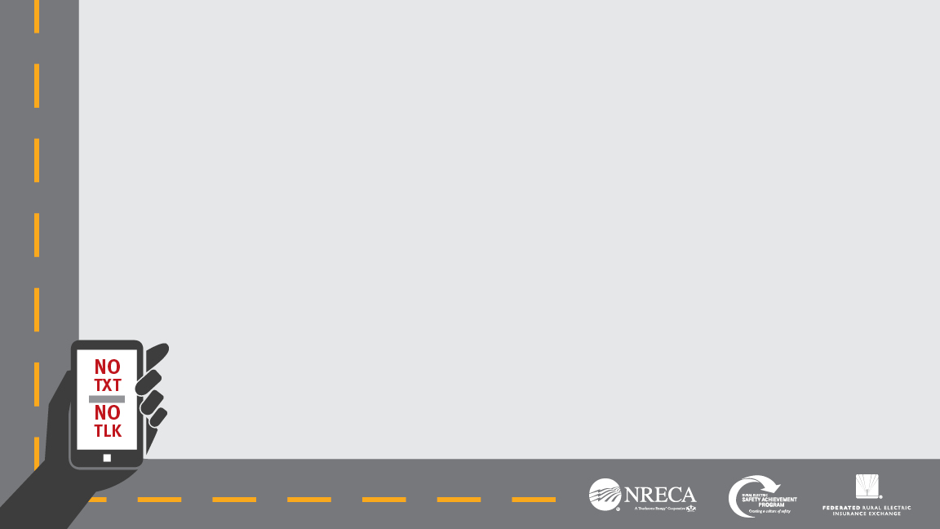
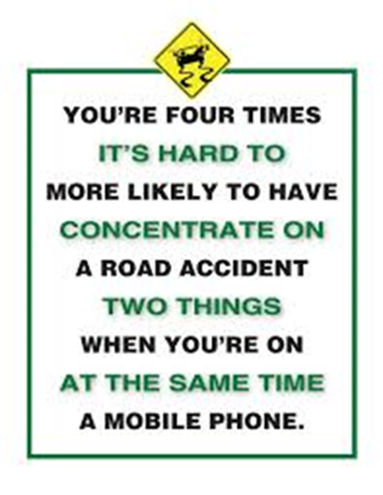
What is Distracted Driving?
noun dis·trac·tion \di-ˈstrak-shən\
Distraction is defined by the National Highway Traffic Safety Administration (NHTSA) as a specific type of inattention that occurs when drivers divert their attention away from the task of driving to focus on another activity instead.
Drivers don’t realize the dangers posed when they take their eyes off the road and their hands off the wheel to focus on activities other than driving.
Notes:
So before we get too deep into the discussion, let’s see the official definition of “distraction” as it relates to driving, as defined by the National Highway Traffic Safety Administration
Numerous studies have been conducted about driving while performing other tasks, such talking on a phone or texting
Driving while on a cell phone is not only dangerous, it is illegal in many states (note the laws in your state)

Slide 3
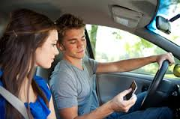
Why is a Co-op Talking to You About Your Driving?
As a co-op, one of our operating principles is Concern for Community.
We have an ongoing commitment to safety.
Youth are most impacted by distracted driving.
Working together, we can significantly reduce the number of traffic crashes and injuries that impact our workforce, family members and communities.
Cooperative Principle #7 Concern for Community
Notes:
The number one cause of death for teenagers in the U.S. is car crashes.
Many of the fatal car crashes are caused by distracted driving
I’m NAME, TITLE w/ NAME OF CO-OP
Co-ops, including ours, all operate under a set of guiding principles – one of them is a Concern for Community – which is why we’re here today
We care about the community – including the young people, who are impacted significantly by distracted driving
We also care about the safety of our employees – and distracted driving is the number one cause of death in the workplace
So by talking about distracted driving it’s really addressing some of our core values
Distracted driving impacts everyone – those who drive; those who are passengers; pedestrians; bystanders etc.
I want to say early on that I’m not here to lecture. The purpose here is really to start a conversation to discuss a serious problem that impacts everyone in this room and in our community.
This is part of our ongoing commitment to safety
We can all do our part to stay safe and make the roads safer for our community
Which is why we are here today
It is our hope that we can promote a culture of safety not only here at the co-op, but you can continue this conversation at home with your family and friends.
We are initiating this program along with co-ops across the country to make our corner of the world safer – but we can’t do it without you
Resources:https://www.osha.gov/distracted-driving/initiative.html

Slide 4
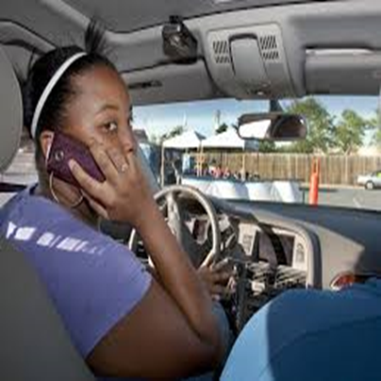
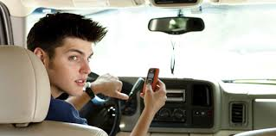
Car Crashes are the Leading Cause of Death for American Teenagers
Distraction is a factor in 58% of moderate to severe teenage accidents.
Cell phone use is so consuming that half of all the teenagers who caused rear end collisions were still driving at full speed upon impact.
Notes:
So I started out with this fact – and if I was a teenager sitting where you are – I’d be pretty concerned about these statistics
This makes sense though – the youngest and most inexperienced drivers are most at risk – and pose the greatest risk to others
It’s a mistake to think that because you are young, nothing will happen to you
No one PLANS to be in an accident – but you can lessen your risk when driving by simply being smart – making good choices in the car to maximize your safety
One other key piece of info. – American Automobile Association calls the days between Memorial Day and Labor day the 100 most deadly days for young drivers, as this is when the greatest number of accidents occur involving young drivers (graduation parties, beach week, summer break); Drivers in their 20s make up 27 % of the distracted drivers in fatal crashes.
While younger drivers are most at risk, it really means that we are all at risk*—we all share the road.*

Slide 5
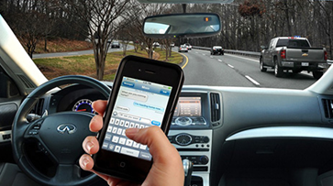
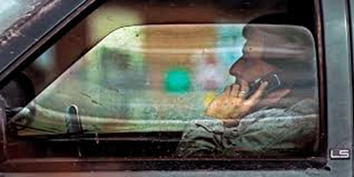
Distracted Driving is a BIG Problem!
An Estimated 1 in 4 Car Crashes Involves Cell Phone Use.
When talking on a cell phone, drivers can miss seeing up to half of what's around them -- traffic lights, stop signs, pedestrians.
​Many distractions exist while driving, but cell phones are a top distraction because so many drivers use them for long periods of time each day.
Almost everyone has seen a driver distracted by a cell phone, but when you are the one who is distracted, you often don't realize that driver is you.
Notes:
Obviously distracted driving is a problem for adults as well
People fee pressure to remain in constant contact even when behind the wheel
We have all seen drivers who were so busy on their phone that they are clearly not paying attention to what is going on around them.
If we’re honest with ourselves, most of us have been the one not paying attention at some point.
We need to recognize the fact that WE are those distracted drivers – driving and using a phone is not multi-tasking – it’s driving while distracted and it can be a fatal decision. No conversation or correspondence is worth someone getting hurt or losing their life.
These stats are from the National Safety Council http://www.nsc.org/learn/NSC-Initiatives/Pages/distracted-driving-research-studies.aspx

Slide 6


Five Facts on Distracted Driving
 | Five seconds is the average time your eyes are off the road while texting. When traveling at 55mph, that's enough time to cover the length of a football field.
 | Device-related tasks like reaching for a phone, dialing and texting, increased the risk of getting into a crash by three times.
 | Phone conversations of any type increase risk; including increased reaction times, increased variations in speed, lane deviations, and steering wheel control.
 | Talking on a cell phone quadruples your risk of an accident, about the same as if you were driving drunk. Risk doubles again if you are texting while driving.
 | Youth most at risk. Car crashes are the #1 cause of death for teenagers. Drivers in their 20s make up 27 % of the distracted drivers in fatal crashes.
1
2
3
4
5
Notes:
There are lots of information and statistics out there on distracted driving, here are just a few key facts I want to share
The first one is pretty sobering -- this is even scarier if you are traveling at a faster speed
Do you all have a football field? ----- Next time you walk by your school’s football field, think about this! If you are on the highway and text, it’s like driving the length of your school football field blind-folded -- that’s an awful lot to miss
Talking on a cell phone quadruples your risk of an accident, about the same as if you were driving drunk. Think about it – you know how impaired a person’s judgment and reflexes are when they have had too much to drink – they are slow, not quite coordinated. this is essentially the same level of reflexes – slow, a beat or two off – enough time to drift into another lane; or not hit the brakes to avoid a pedestrian or the car in front of you; or react to someone else’s mistake
That risk doubles again, to eight times normal, if you are texting.
Resources:
#1(2009, VTTI)
#2(2009, VTTI)
#3 (AAA Foundation)
#4 (Univ. Utah research by Dr. David Strayer)
#5 (CDC)

Slide 7
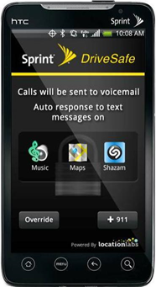
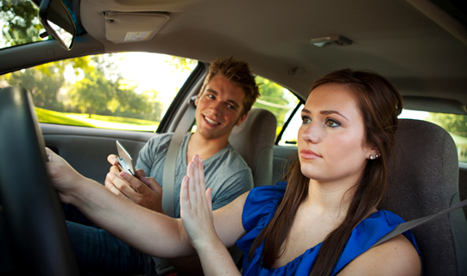
Simple Actions Can Make a Difference
Take and share the No Text, No Talk Pledge.
Talk to your family and friends about the dangers of texting and driving.
Designate a texter or caller the next time you drive.
Put your phone out of sight/reach next time you drive.
Ask the young people in your car to put their phones away.
Turn notifications off. The less you hear your phone, the less tempted you'll be to respond while driving.
Install an app like Drive First or ZoomSafer to automatically send a message that you’re driving and will respond later.
Notes:
There are some simple actions you can take when you are the driver, starting with taking the pledge not to text and talk on the phone while driving
A lot of these are simple steps
Can I get a show of hands if you are already doing any of theses things?
Many apps to assist you. Some notify specific contacts automatically as to when and where you're driving. The app also offers enhanced controls for parents, like safety logs that can help hold younger drivers accountable for their actions when they're driving alone.
The Textecution app is a "locking" app that disables text and email functionality when you're moving beyond a certain speed. It even comes with controls to help avoid disabling the locking if a user removes Textecution from the phone, there is an option for another user, likely a parent, to be notified by text.
Sprint announced that it will pre-install a safe driving app on all the devices it sells
Can I get a show of hands from those who have a safe-driving app?
Resource: Examples of apps
https://www.libertymutual.com/safe-and-smart-living/blog-posts/distracted-driving-prevention-tools?CAT=Auto&src=lmcm-s-ggl-brd201401120450

Slide 8
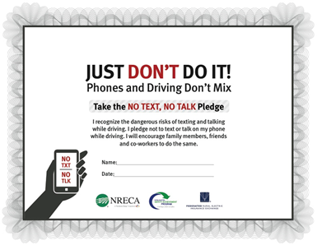
JUST DON’T DO IT!
YOU are MOST at RISK!
Texting while driving isn’t multi-tasking, it’s essentially driving blind.
Some activities—such as texting—take the driver’s attention away from driving more frequently and for longer periods than other distractions.
We all have the power and influence to do something about this danger – and we can start right now.
Notes:
There is no sugar-coating the facts – texting and/or talking on a device while driving can have devastating, often deadly results
You are most at risk – so you need to take this statistic to heart and act on it – keep yourself, those in your car and on the road safe
We are all guilty of this at one time or another
When you are doing it, most people think, checking that ONE text, or picking up that ONE urgent call, just for a brief time is NOT going to cause harm – but the fact is, you increase the likelihood of an accident every time you use a phone and drive
No one plans to be in an accident, and yet they happen every day, in every community
We can all pledge to improve
We all have family and friends that would be heartbroken if you were lost or permanently injured due to an accident involving distracted driving – whether you are at fault or were the victim
Be strong – put the phone away when you are driving

Slide 9
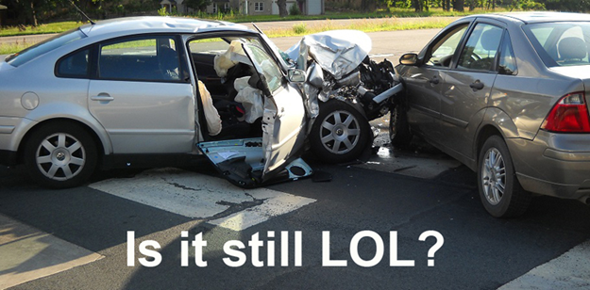
Questions/Discussion
Notes:
NOTE: Keep this slide up during the discussion
NOTE: Insert a Name and contact info. if there is a particular point of contact at your co-op
DISCUSSION TOPICS –
Ice breaker
Show of hands for those that already have their license
Show of hands for those that will be getting their license in the near future -- next year
Show of hands for those whose parents or another family member have talked with them about distracted driving
Show of hands for those who have been in a car and experienced a “near miss” because the driver was on the phone
Show of hands for those who know of someone who was in an accident involving distracted driving
Discussion
What are your biggest take-aways from this presentation
What have your parents, or another family member said about distracted driving
What about the aps – do you have any recommendations and/or comments on some of the aps or other technology out there
What are some of the things, steps your family or friends are doing to address the temptation of using a phone while driving
Do you have any additional ideas or tips to help combat the distraction from your phone
What do you think the biggest barrier is in changing behavior – not using a phone while driving– especially among young people
As we (co-op name) talk with other young people about this problem, what do you think we should say to them about distracted driving? What message can we convey that would have the biggest impact

