Slide 1
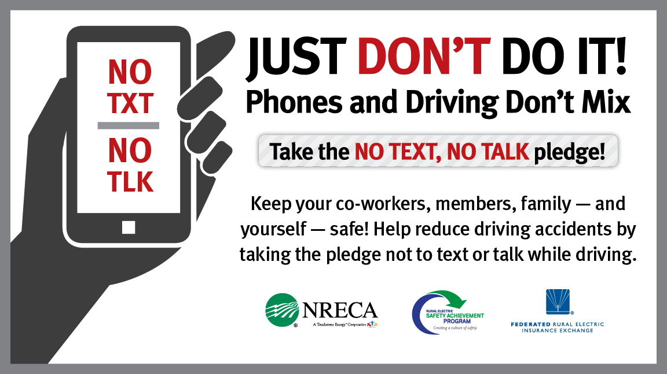
Notes:
Distracted driving due to phone use is a serious public health hazard
In fact, U.S. Dept. of Transportation calls it an epidemic
We have all seen distracted drivers, and most likely, everyone in this room has used their phone while driving or you have been in a car where the driver was using his/her phone
Resource: Dept. of Transportation Distracted Driving campaign: http://www.distraction.gov/

Slide 2
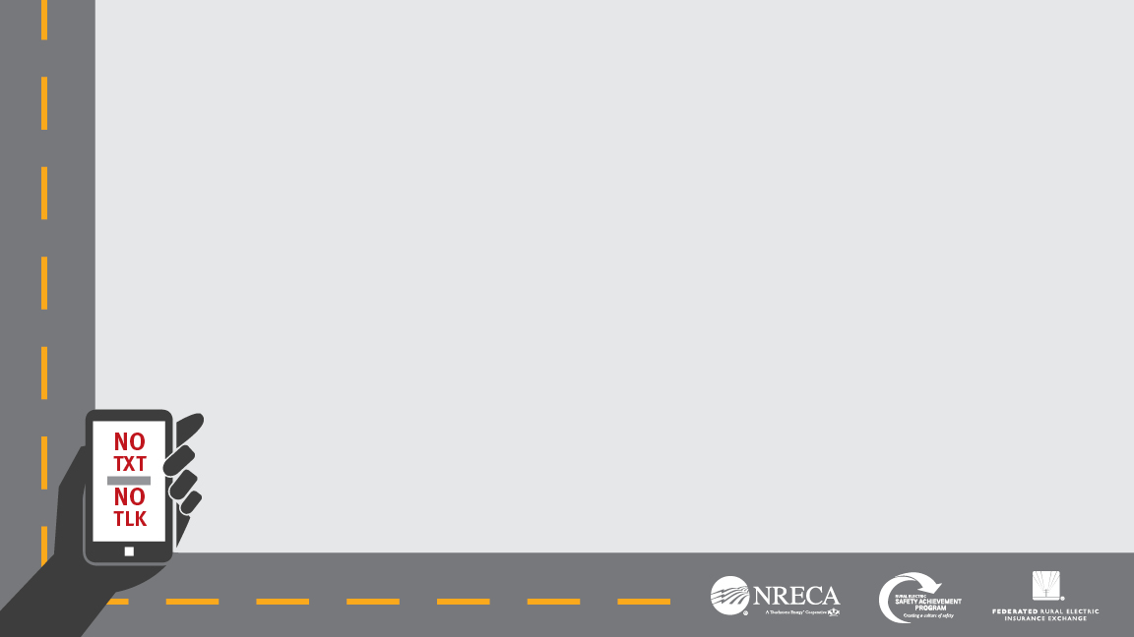
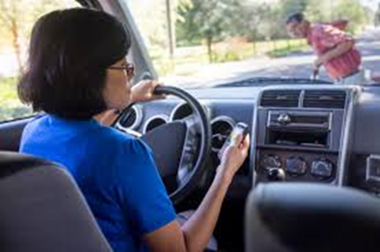
Why Is Your Co-op Talking to You About Your Driving?
Distracted driving is the #1 cause of workplace deaths in the U.S.
Part of our ongoing commitment to safety and Concern for Community
Working together, we can significantly reduce the number of traffic crashes and injuries that impact our workforce, family members and communities
Cooperative Principle #7 Concern for Community
Notes:
Distracted driving impacts everyone – those who drive; those who are passengers; pedestrians; bystanders etc.
As a practical matter, distracted driving is the No. 1 cause of workplace deaths in the United States, according to the Occupational Safety and Health Administration (OSHA).
I want to say early on that I’m not here to lecture. The purpose here is really to open up a dialog, to discuss a serious problem that impacts everyone in this room and in our community.
This is part of our ongoing commitment to safety and part of the Rural Electric Safety Achievement Program (RESAP)
We can all do our part to stay safe and make the roads safer for our community
Which is why we are here today
It is our hope that we can promote a culture of safety not only here at the co-op, but you can continue this conversation at home with your family and friends.
We are initiating this program along with co-ops across the country to make our corner of the world safer – but we can’t do it without your help.
Resources: https://www.osha.gov/distracted-driving/initiative.html

Slide 3


Five Facts on Distracted Driving
 | Five seconds is the average time your eyes are off the road while texting. When traveling at 55mph, that's enough time to cover the length of a football field.
 | Device-related tasks like reaching for a phone, dialing and texting, increased the risk of getting into a crash by three times.
 | Phone conversations of any type increase risk; including increased reaction times, increased variations in speed, lane deviations, and steering wheel control.
 | Talking on a cell phone quadruples your risk of an accident, about the same as if you were driving drunk. Risk doubles again if you are texting while driving.
 | Youth most at risk. Drivers in their 20s make up 27 % of the distracted drivers in fatal crashes.
1
2
3
4
5
Notes:
Here are a few facts to share – there is lots of research and info. out there about distracted driving, but here are just a few key facts I want to share
The first one is pretty sobering -- this is even scarier if you are traveling at a faster speed
Youth most at risk – not much of surprise – most inexperienced; most apt to text/use a phone while driving
Talking on a cell phone quadruples your risk of an accident, about the same as if you were driving drunk. That risk doubles again, to eight times normal, if you are texting.
Texting while driving is linked with drinking and driving/riding with someone who has been drinking among high school students. (CDC)
Resources:
#1(2009, VTTI)
#2(2009, VTTI)
#3 (AAA Foundation)
#4 (Univ. Utah research by Dr. David Strayer)
#5 (CDC)

Slide 4
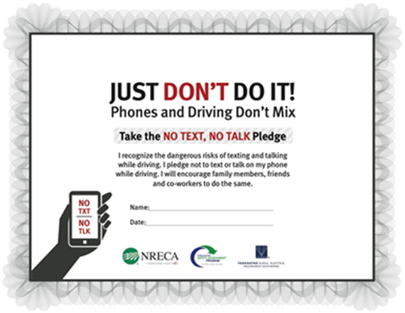
What Are We Doing About This?
Participating in the JUST DON’T DO IT! campaign
Promoting a culture of safety
Fostering conversation about the dangers of distracted driving
Setting a good example by taking the pledge
Presenting at local high schools to help educate community youth on the dangers of distracted driving
Featuring the campaign at our annual meeting
Notes:
NOTE: You can insert the logo of your co-op here
So the center piece of our program is a pledge – to not text and talk on the phone while driving – it’s something we can all do to make our rides safer and those of our loved ones, friends, colleagues and community
The pledge – is a simple document to sign indicating that you pledge not to use your phone while driving
It’s a great way for anyone, but particularly parents and their children to sign together – parents are modeling good behavior and young people are forced to think about their actions; it’s also a way for parents to hold their young drivers accountable if they don’t live up to the pledge
We are talking to our members, to high schools and community groups to get this conversation going in our surrounding community
We are circulating the Pledge through our various co-op channels
And sharing information and tips to combat distracted driving.
There are some other simple actions you can take -- for more info. about this, check out the materials and info. on our web site (send to web site)
NOTE-- If you brought handouts from the tool kit, reference these

